Slide 1
Screen Time and Obesity
By Group 3: Chaya Wertman, Daniela Arias, Erik Oatman, Jeanine Alokush, Shana Brawer

Slide 2
What is the problem?
Kids’ physical health is being negatively impacted by the long hours spent in front of a screen

Slide 3
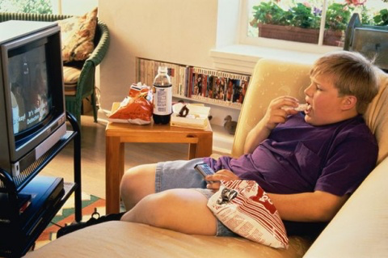

Slide 4
What is screen time?
Screen time refers to time spent with any screen, including smart phones, tablets, television, video games, computers or wearable technology

Slide 5
Kids these days ...
They’re spending way too much time in front of a screen

Slide 6
What are the recommended screen time limits?
The American Academy of Pediatrics recommends a maximum of 1 hour per day of screen time for children aged 2-5 and no screen time for children under the age of 2.
https://www.aap.org/en-us/about-the-aap/aap-press-room/Pages/American-Academy-of-Pediatrics-Announces-New-Recommendations-for-Childrens-Media-Use.aspx

Slide 7
However...
One study done at the University of Washington of 8950 children under the age of 5 found that 66% exceeded that limit, spending an average of 4.1 hours of daily screen time, 90% of which came from home
(https://www.ncbi.nlm.nih.gov/pmc/articles/PMC4338000)
Another study in the U.S. found that the average child between 8 months and 8 years of age is exposed to nearly 4 hours of background TV on a typical day
(Lapierre MA, Piotrowski JT, Linebarger DL. ) pediatrics.aappublications.org/content/pediatrics/130/5/839.full.pdf?download=true

Slide 8
Which health problems are associated with excessive screen time?
Elevated cholesterol levels
Insulin resistance
Hypertension
Metabolic syndrome
Elevated inflammation
OBESITY
And the focus of this presentation...
https://www.ncbi.nlm.nih.gov/pmc/articles/PMC5769928/pdf/nihms931685.pdf

Slide 9
Childhood obesity is considered one of the most serious public health challenges of the 21st century.

Slide 10
1 in 5
!
!
!
Data shows that nearly
!
!
!
!
!
children and adolescents is obese.
https://www.cdc.gov/healthyschools/obesity/facts.htm
!

Slide 11
Screen Time and Obesity
In a longitudinal study done in New Zealand, up to 17% of the overweight prevalence found in 26-year-olds was found to be associated with watching more than 2 hours of TV on weekdays as a child or adolescent.
https://www.ncbi.nlm.nih.gov/pmc/articles/PMC5769928/pdf/nihms931685.pdf

Slide 12
Screen Time and Obesity
One randomized controlled trial compared 3rd and 4th grade students of 2 California schools
One school received 7 months of screen-reduction interventions, while the other school received NOTHING.
https://www.ncbi.nlm.nih.gov/pubmed/10546696/

Slide 13
After 7 months, the students in the school that received intervention exhibited a significantly slowed gain in:
BMI
Triceps skinfold thickness
Waist circumference
and waist-to-hip ratio
compared to kids in the other school.
https://www.ncbi.nlm.nih.gov/pubmed/10546696/

Slide 14
Screen Time vs. Physical Activity
“Does screen time displace physical activity?”
2017 report by Stanford, Stoney Brook, and Northeastern cited multiple epidemiologic studies, cross-sectional and prospective cohorts, and experimental study that imposed reduced screen time [1].
2018 cross-sectional study in Ireland by Dublin City University: sample of 169 students (113 boys, 56 girls; avg. 13 y/o); part of a larger longitudinal study initiated in 2010; self-reported screen time, MVPA monitored with accelerometer, and BMI recorded before and after 9 days [2].
https://www.ncbi.nlm.nih.gov/pmc/articles/PMC5769928/pdf/nihms931685.pdf
https://www.ncbi.nlm.nih.gov/pmc/articles/PMC6162488/

Slide 15
Well?...
The 2017 Stanford report and the 2018 Ireland study both failed to establish a consistent correlation between increased Screen Time and decreased physical activity, which runs contrary to popular assumption.
One of the experimental studies in Stanford’s report reduced screen time did not lead to increased physical activity.
If screen time isn’t necessarily displacing physical activity, then how does it relate to increased childhood obesity rates?

Slide 16
Not That Simple….
While reduced physical activity is one of the more obvious risk factors to consider between screen time and obesity, there are others that need to be considered.
The 2017 Stanford report expands on 3 other risk factors also associated with screen time and childhood obesity.

Slide 17
Risk Factors
Increasing energy intake from eating while viewing
Advertising
Reducing sleep

Slide 18
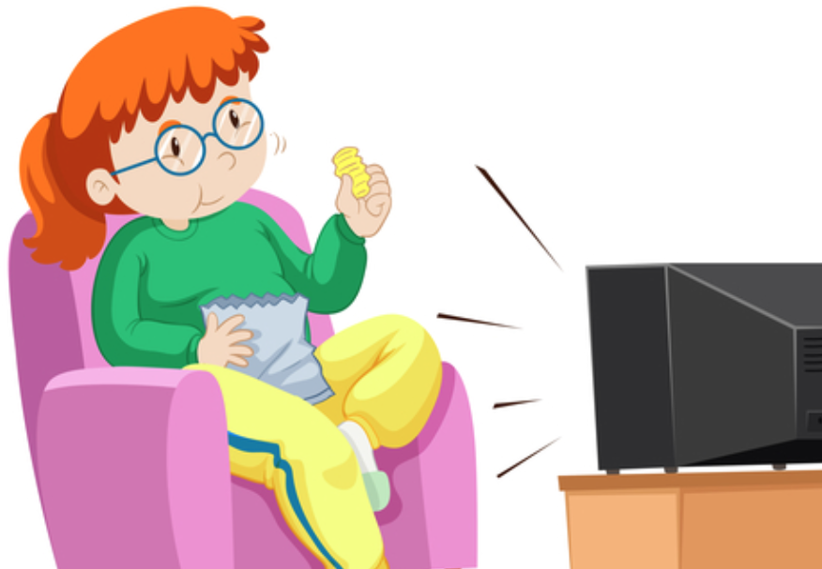
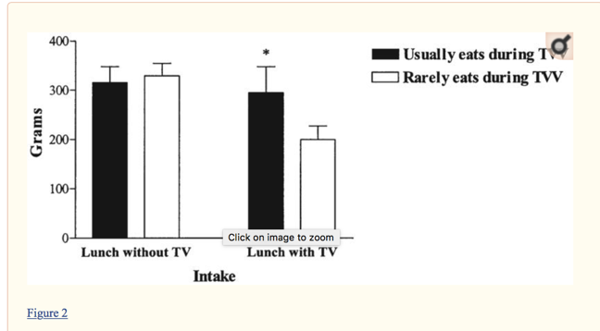
Food Intake and Screen Time
Epidemiologic studies have shown that children exposed to more screen time tend to consume less fruits and vegetables. On the contrary, these children consume more fast food, high energy drinks and snacks.
In another study performed in Pennsylvania with 24 children (12 males, 12 females), it was found that children with previous habits of eating and watching TV consumed higher energy intake at lunch while watching TV as compared to children with not such previous habits.

Slide 19
Advertisement and Screen time

Slide 20
Advertisement and Screen Time
According to the Federal Trade Commission, “food and beverage companies spent $1.8 billion on marketing to children and adolescents in the United States in 2009.”
In 2014, kids aged 2-11 and adolescents aged 12-17 years old saw approximately 12.8 and 15.2 advertisements related to food, beverages and restaurant commercials per day on TV, respectively.
In a randomized controlled trial in which food advertisement was presented through animated programs, it was found that advertisement automatically increase food intake and not actually being advertised.

Slide 21
Sleep Deprivation and Screen Time
In a systematic literature review, 90% of the studies showed a positive correlation between screen time and sleep deprivation.
Among children of ages 3 to 7, sleep deprivation has been linked to obesity.
There are several factors that can explain sleep deprivation and obesity:
Sleep deprivation causes changes in the hunger and satiety hormones, leptin and ghrelin.
Shorter amount of sleep can alter children’s food selection and can especially lead them to consume more calories.
Sleep deprivation can encourage kids to take to more snack time particularly at night.

Slide 22
Suggestions- Who do we educate?
Parents have a big influence on the amount of time children spend on their devices. Therefore, in order for change to happen, parents need to be informed about the risks of screen time and the maximum amount of time children should spend on their devices.

Slide 23
Suggestions- Who can do the education?
School programs: At the beginning of each school year, mandate that all public schools hold an informational session for parents to attend in which it will address the health risks associated with spending too much time on devices.
Healthcare professionals (pediatricians): Have healthcare providers ask parents how much time their children are spending and also inform them of the risks and suggest time limits for screen time. Make it a habit for these professionals to ask!
Community Health Centers: Have these centers hold informational sessions as well. They can also provide material such as pamphlets regarding the health risks of screen time and how to cut down on it.

Slide 24
Suggestions- What to recommend to parents?
Ideally limit children’s screen time. According to the AAP:
Children younger than 2 years: 0 minutes (Yupp 0!)
Children between the ages of 2-5: 1 hour per day
Don’t have children eat while they are on their devices
Encourage parents to have certain days that are completely screen-free
When the child does have screen time, try to make it educational and be with them when they are using the device
Try not to have devices such as televisions in children's bedrooms
Play sports with them, sing with them, do fun art activities such as making slime, or dance with them!

Slide 26
Suggestions- What else can schools do?
Besides having informational sessions for parents about screen time, schools can have screen free weeks throughout the school year.
During that week, at recess time and during after school programs: encourage children to do some reading, play board games, engage in sports, arts and crafts, dancing, writing, singing, and acting.
http://www.screenfree.org

Slide 27
Suggestions- Community Initiatives
Hold weekly activities/after school programs for children - to encourage children to be active and interact with each other
Develop summer programs for children to attend and include activities such as taekwondo or music lessons.
Develop community awareness programs to educate parents, caregivers and educators about the importance of limiting screen time.

Slide 28
Suggestions- Government Regulations
Federal government can:
Provide funding to state and local governments to work on developing and implementing community initiatives to limit screen time
State and local government can:
Regulate screen time in childcare settings
Provide guidelines to parents and health care providers as to suggestions for screen time limits

Slide 29
Suggestions- A look into the future maybe?
Since the technology industry will continue to develop new and more advanced technology, we should try to develop devices with built in controls in which parents can set a limit and the device will automatically shutdown after a certain allocated time.

Slide 30
Summary
Children are spending a lot of time in front of screens
There is an association between screen time and childhood obesity: one of the most serious public health challenges of our century
Screen time causes children to:
use up energy from food and increase their food intake
be exposed to unhealthy food advertisements
experience reduced sleep

Slide 31
Summary
There is hope!
But we must work together to intervene
We need involvement of:
Parents
Health care providers
Schools
Communities
Federal, state, local governments
We can decrease screen time and the incidence of childhood obesity

Slide 32
References
http://whatworksforhealth.wisc.edu/program.php?t1=21&t2=12&t3=78&id=607
https://www.ncbi.nlm.nih.gov/pmc/articles/PMC2596580/
http://pediatrics.aappublications.org/content/140/Supplement_2/S97
http://www.screenfree.org
https://www.ncbi.nlm.nih.gov/pmc/articles/PMC5769928/pdf/nihms931685.pdf
https://www.ncbi.nlm.nih.gov/pubmed/11158483
https://www.ncbi.nlm.nih.gov/pmc/articles/PMC4338000
pediatrics.aappublications.org/content/pediatrics/130/5/839.full.pdf?download=true
https://www.ncbi.nlm.nih.gov/pubmed/10546696/
https://www.aap.org/en-us/about-the-aap/aap-press-room/Pages/American-Academy-of-Pediatrics-Announces-New-Recommendations-for-Childrens-Media-Use.aspx

